Slide 1
A phylogeny-based analysis of bioactive metabolites in Scutellaria reveals multiple species with significant medicinal potential
Bryce Askey¹, Yeong Hun Song¹, Yoonkyung Lee², Ru Dai¹, Sangtae Kim², and Jeongim Kim^{1,3}
¹Horticultural Sciences Department, University of Florida, Gainesville, FL, USA
²Department of Biology, Sungshin Women’s University, Seoul, Republic of Korea
³Plant Molecular and Cellular Biology Graduate Program, University of Florida, Gainesville, FL, USA

Slide 2
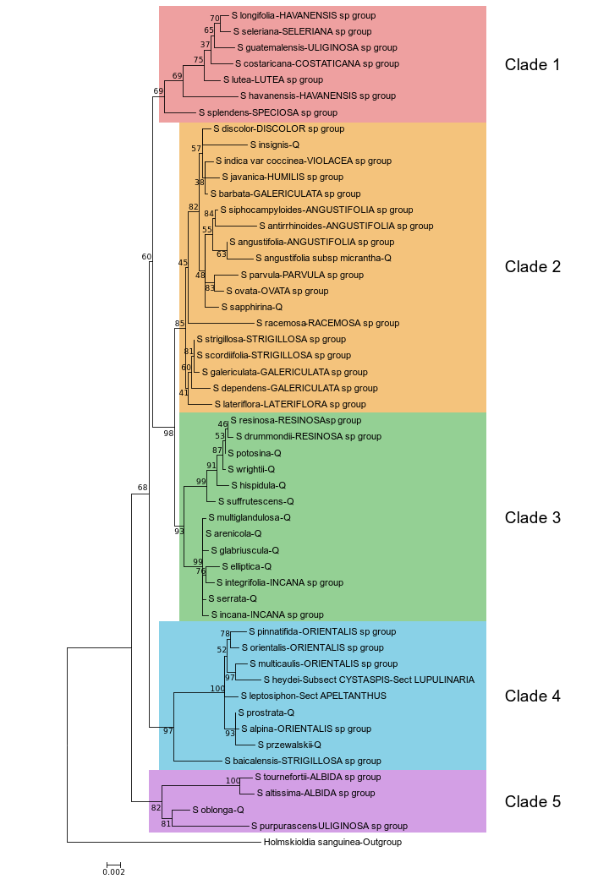
Figure 1. Maximum likelihood phylogenetic tree inferred from 3 chloroplast genome regions for 51 species of Scutellaria and 1 outgroup. To facilitate downstream analysis, the tree is subdivided into 5 color-coded clades based on grouping of species within the tree.

Slide 3
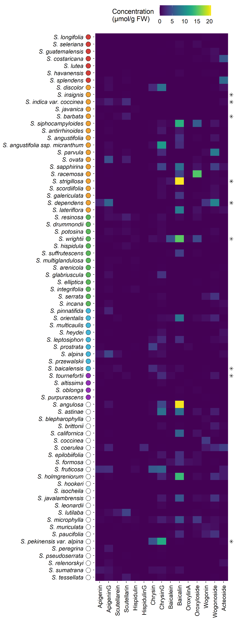
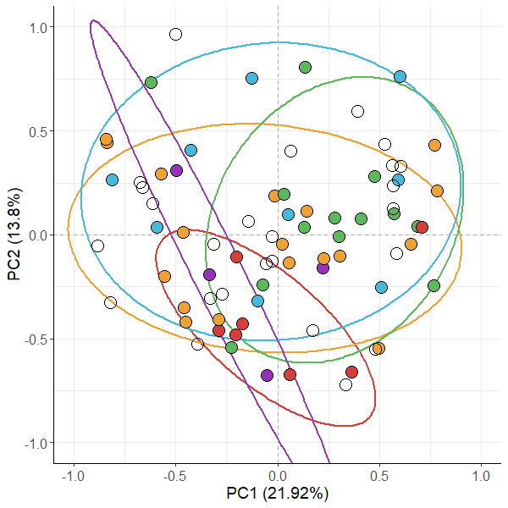
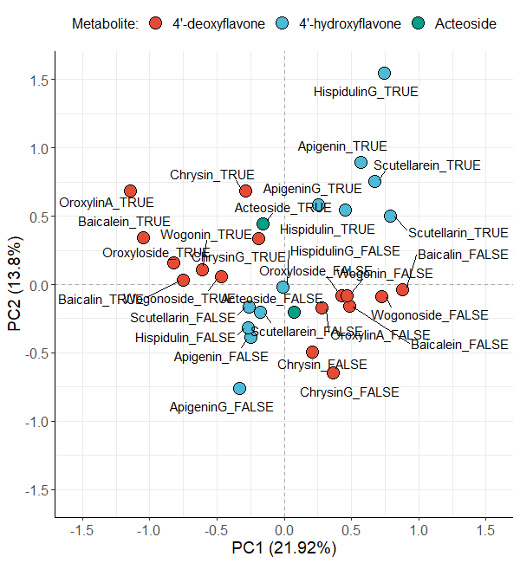
A.
B.
C.
Figure 2. Aerial metabolite concentrations measured with High Performance Liquid Chromatography (HPLC) compared to phylogeny for 76 species of Scutellaria. (A) Heatmap of collected data. Data is shown in units of µmol/g fresh weight. Fresh weight of herbarium samples was estimated by multiplying their dry weight by a factor of 10. Species for which fresh tissue was used are indicated by an asterisk on the right side of the heatmap. Samples for all other species were prepared from herbarium vouchers. Colored circles next to species names indicate phylogenetic clade, as shown in Figure 1. An empty circle indicates that the species was not included in the tree from Figure 1. (B) Multiple Correspondance Analysis (MCA) individual results with overlaid 80% confidence ellipses generated from binarized metabolite data. Each colored circle represent a species, and the color of the circle represents phylogenentic clade, as shown in Figure 1. The percentage of total variance explained by each principal component is shown next to each axis title. (C) Variable loadings from MCA. Each variable represents the prescence (indicated with “TRUE) or absence (indicated with “FALSE) of a metabolite, and are color-coded according to metabolite class.

Slide 4
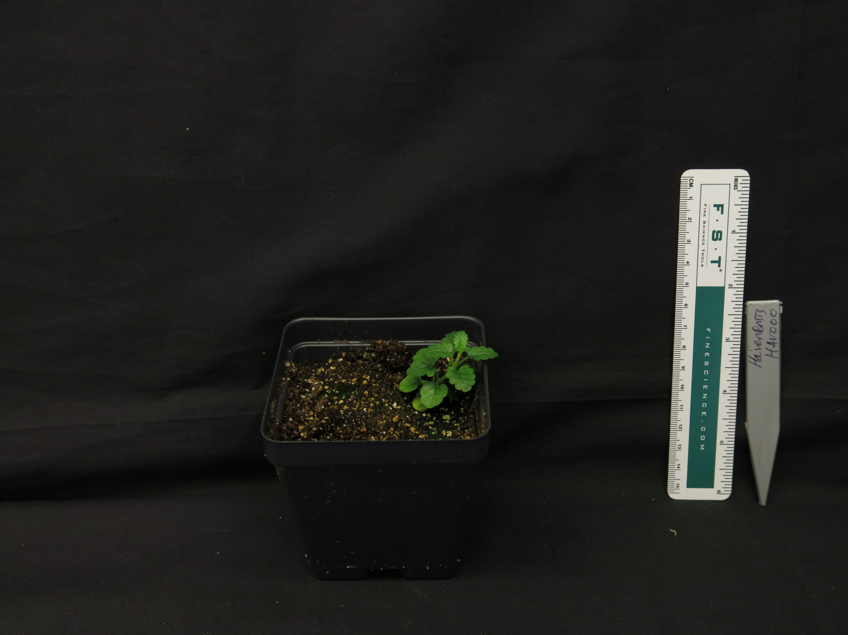
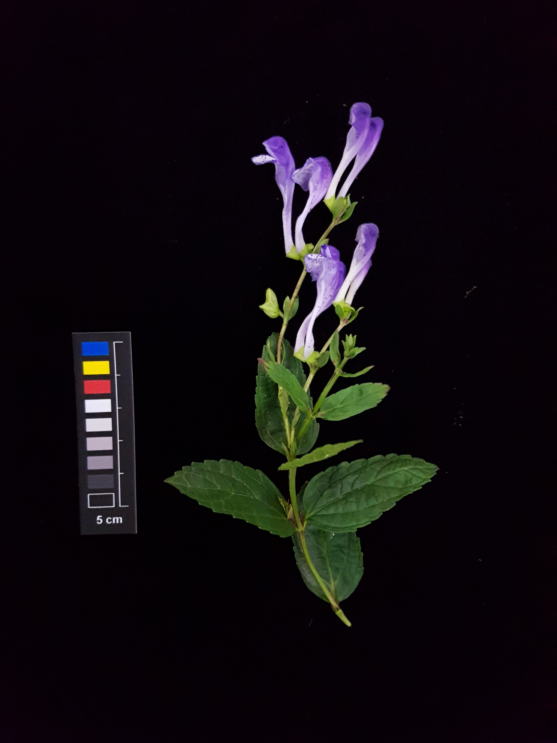
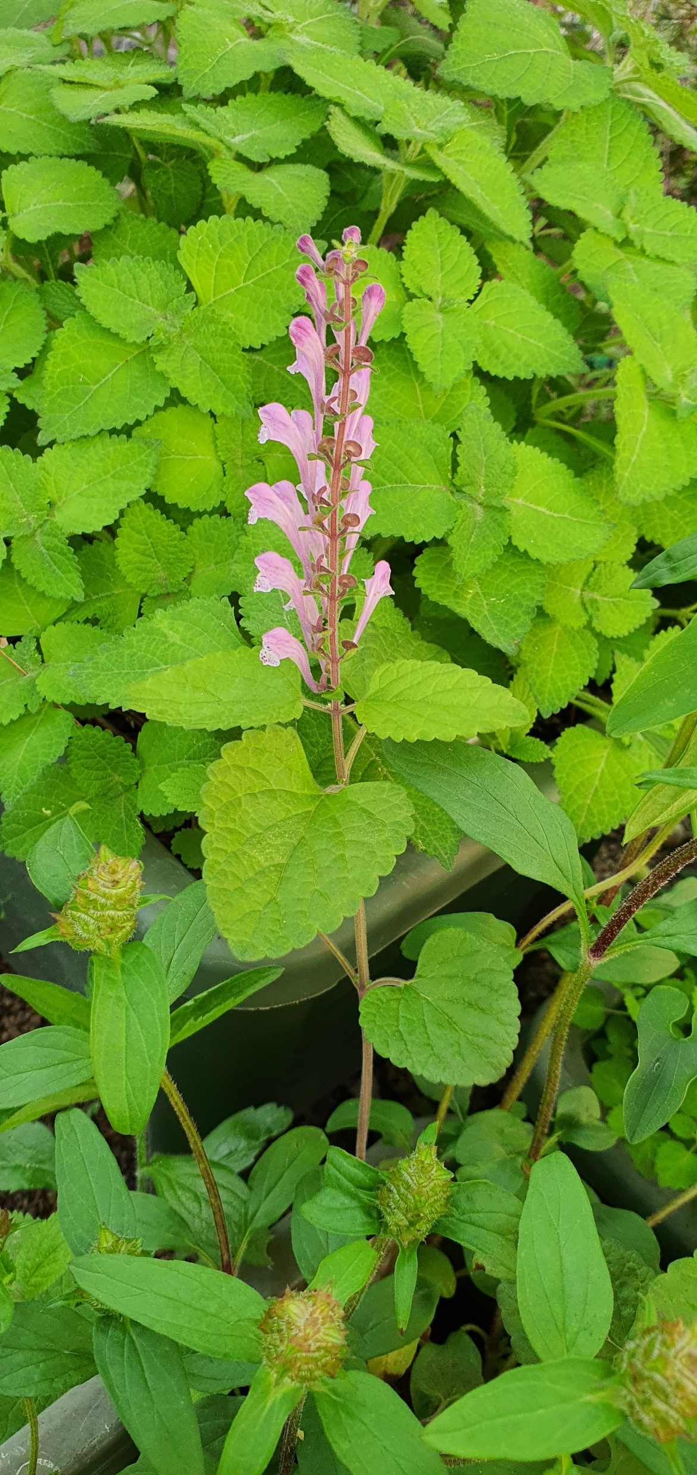
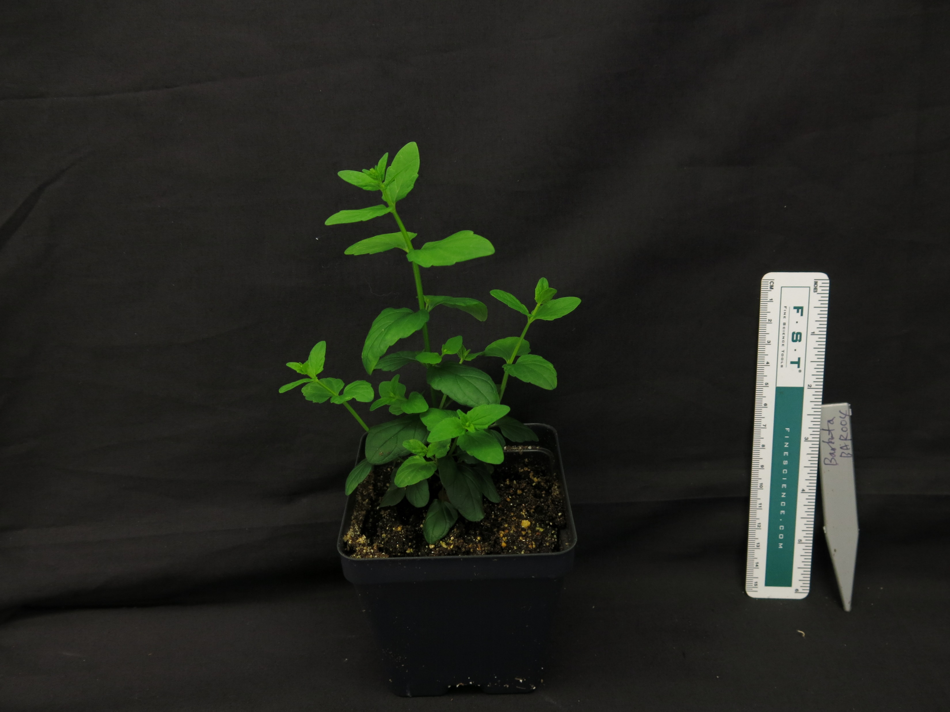
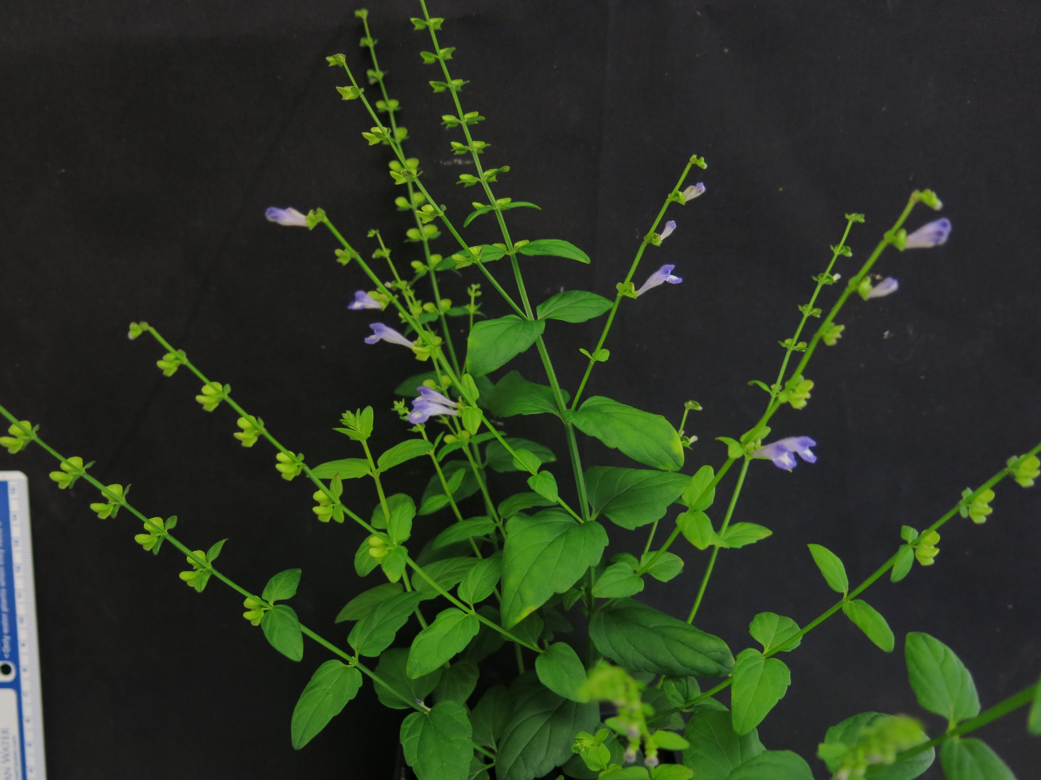
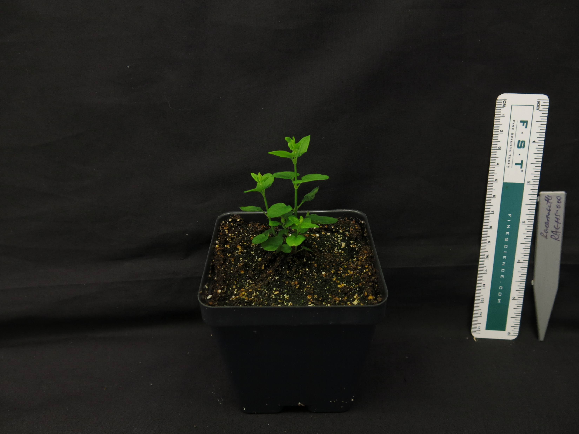
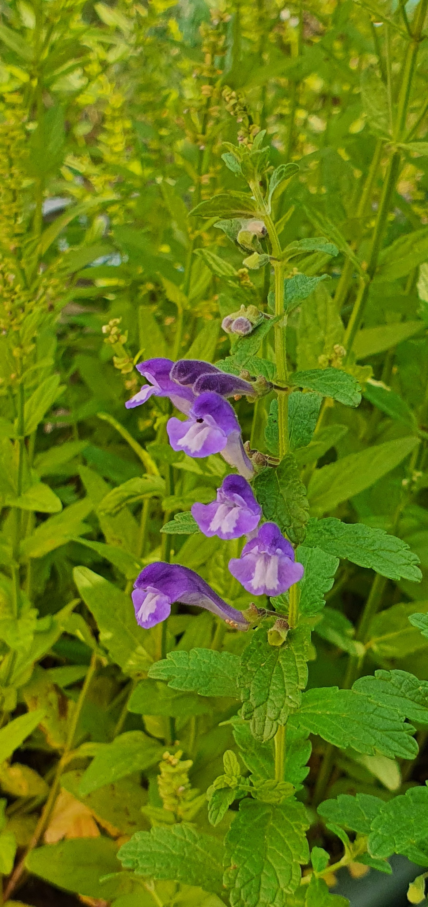
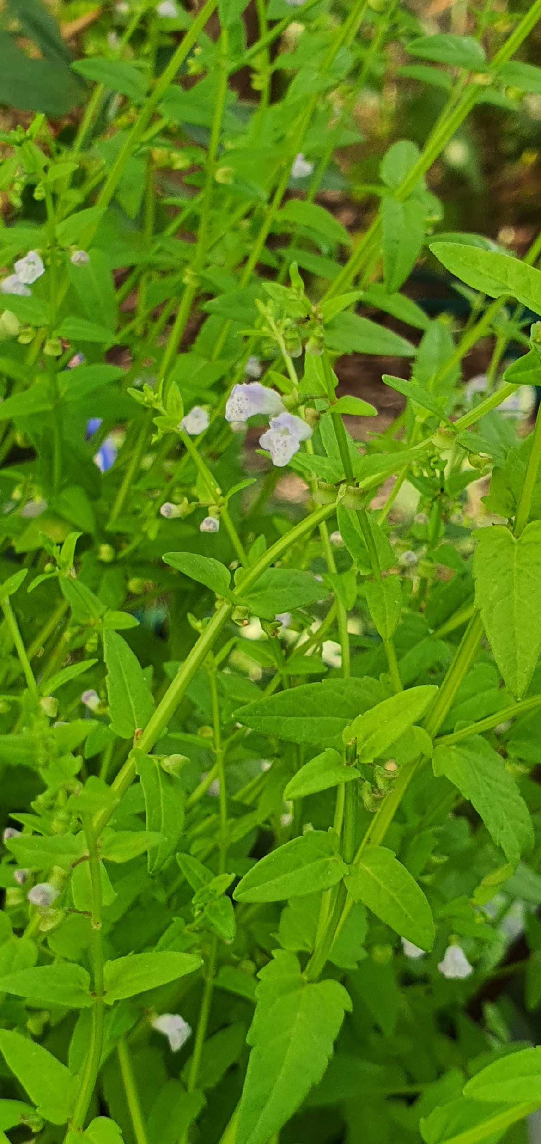
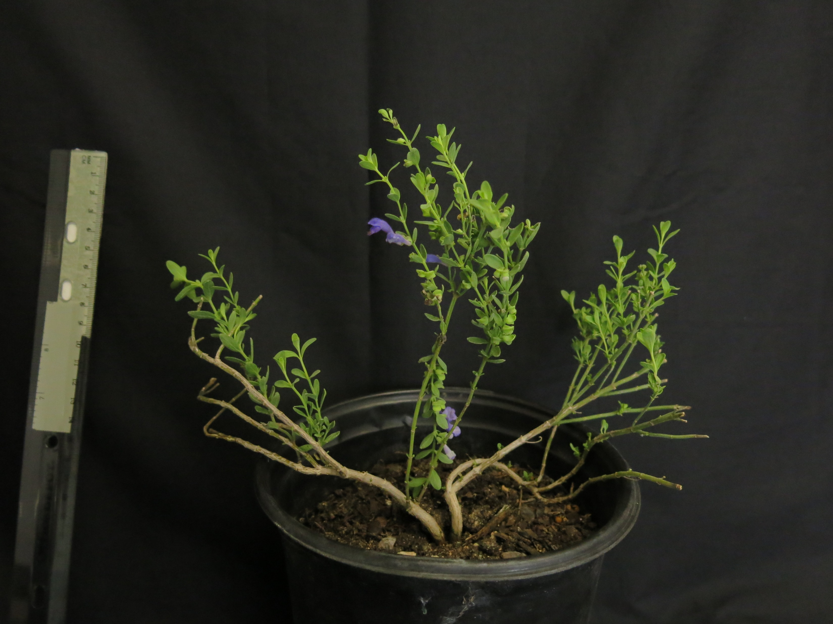
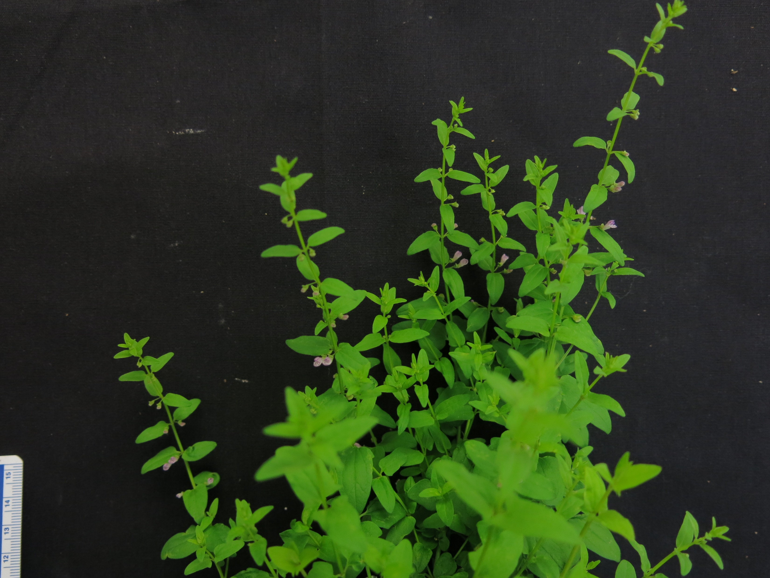
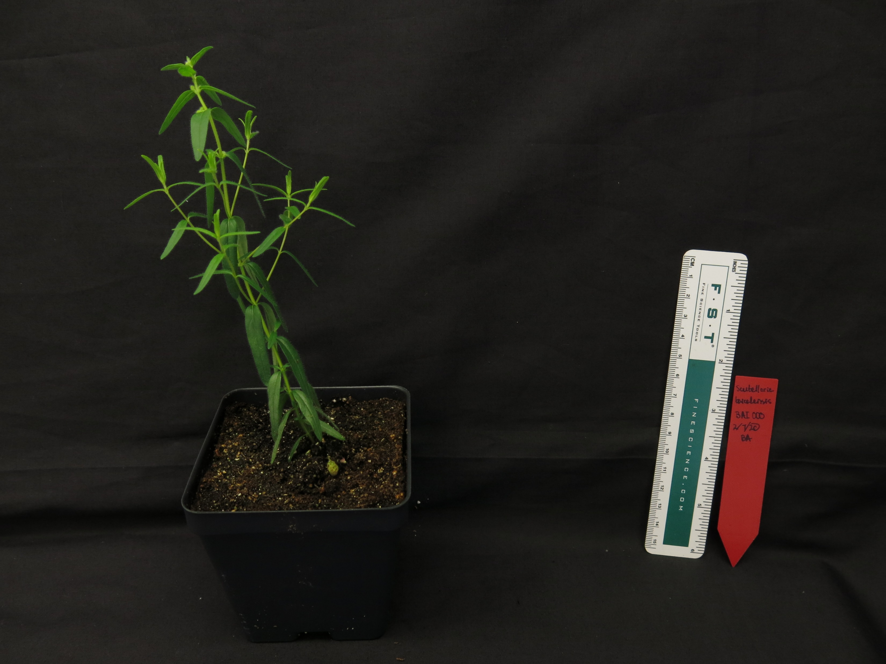
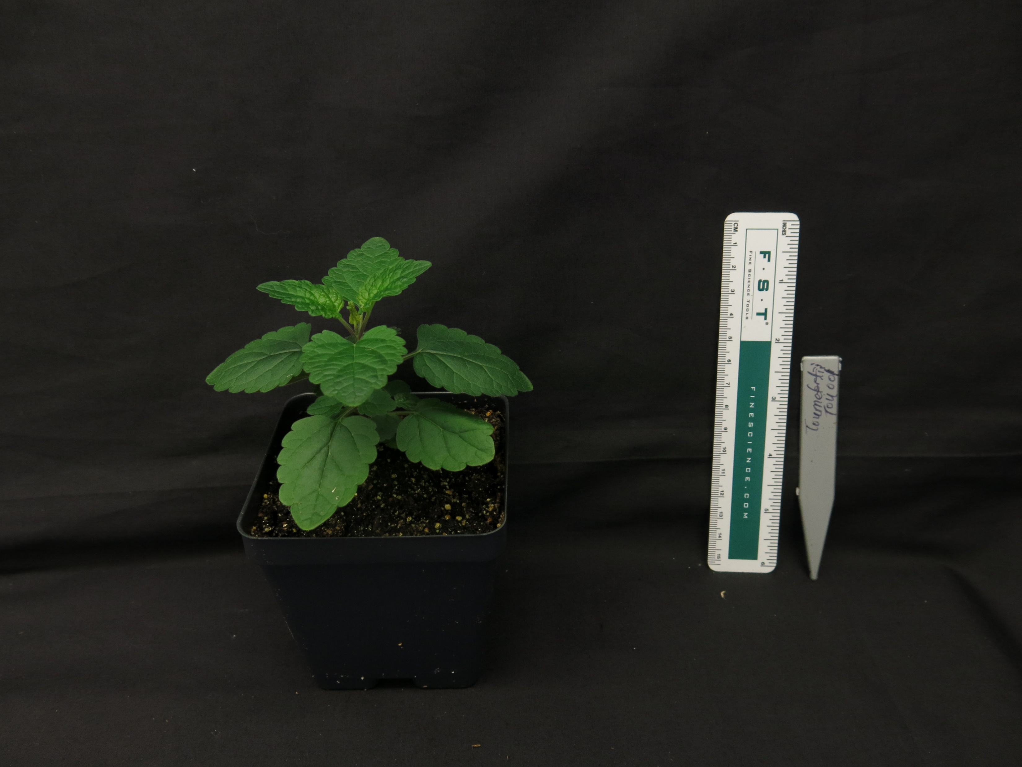
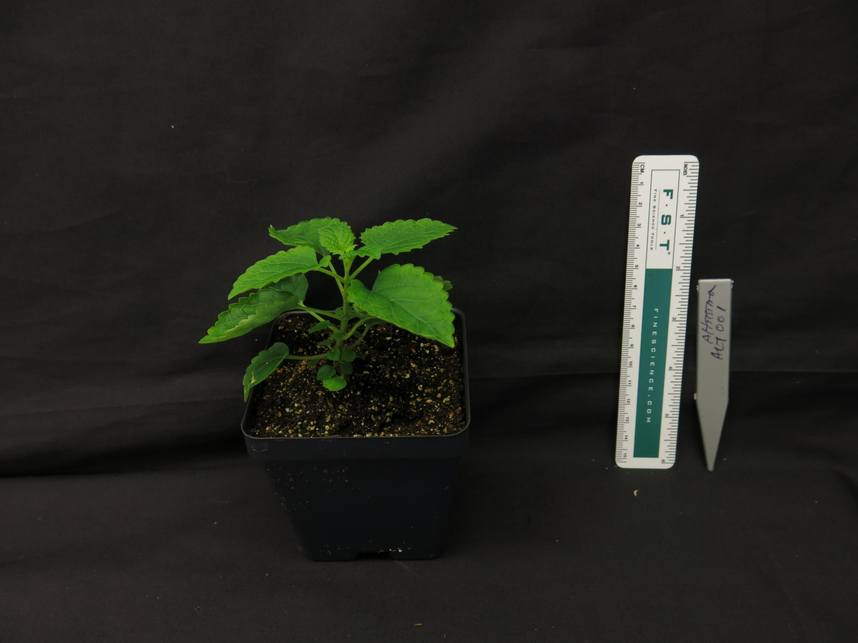
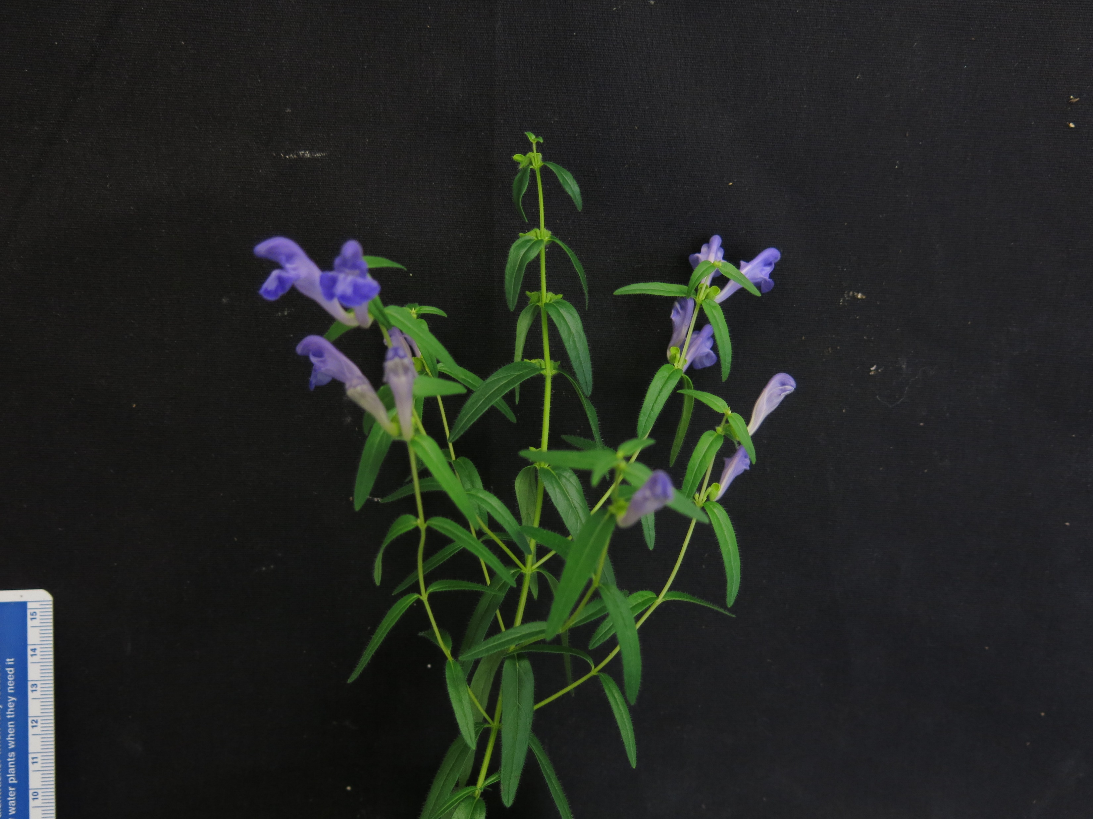
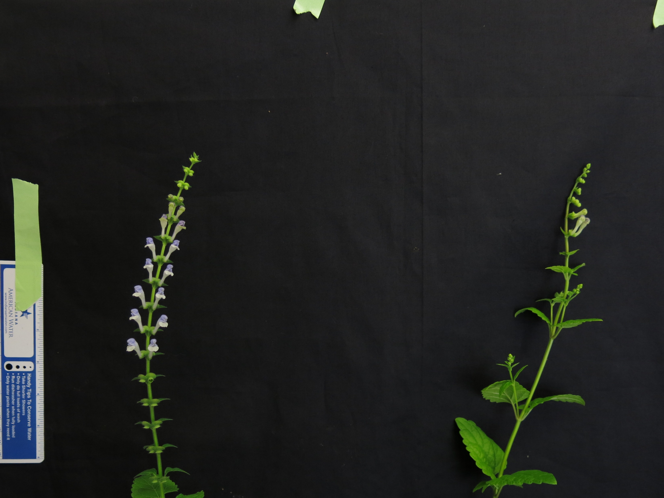
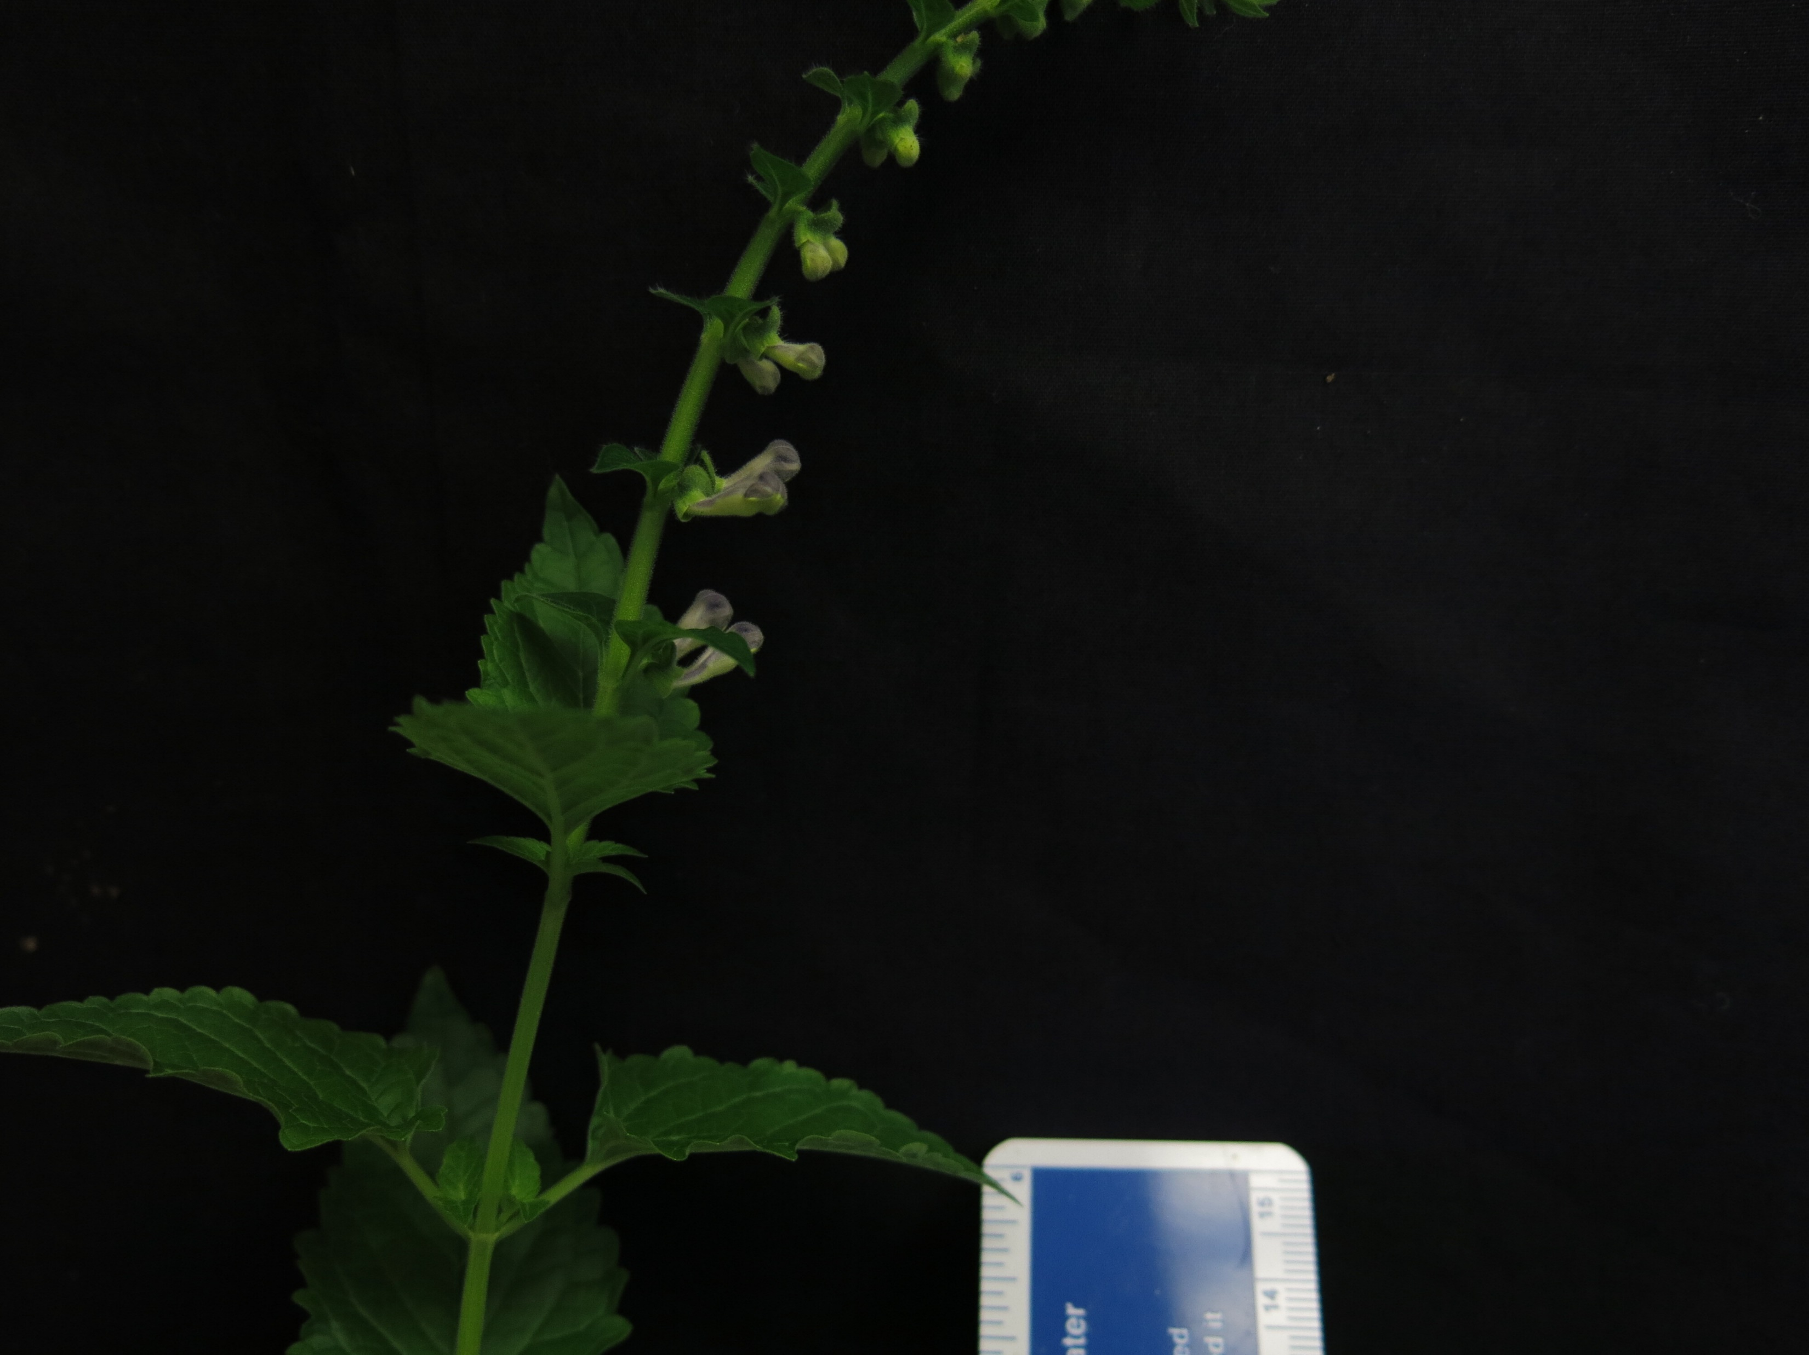
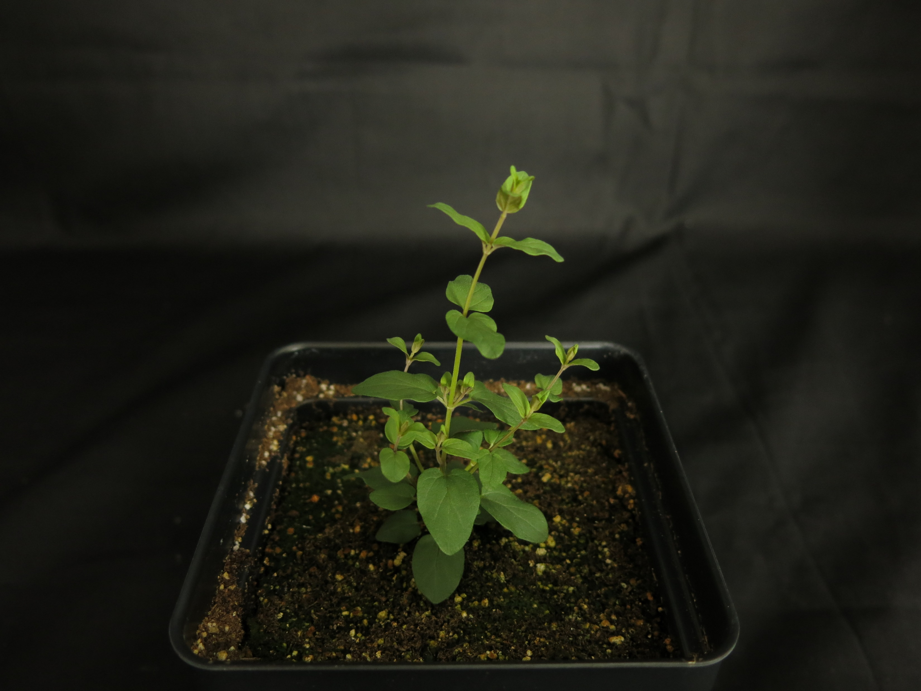
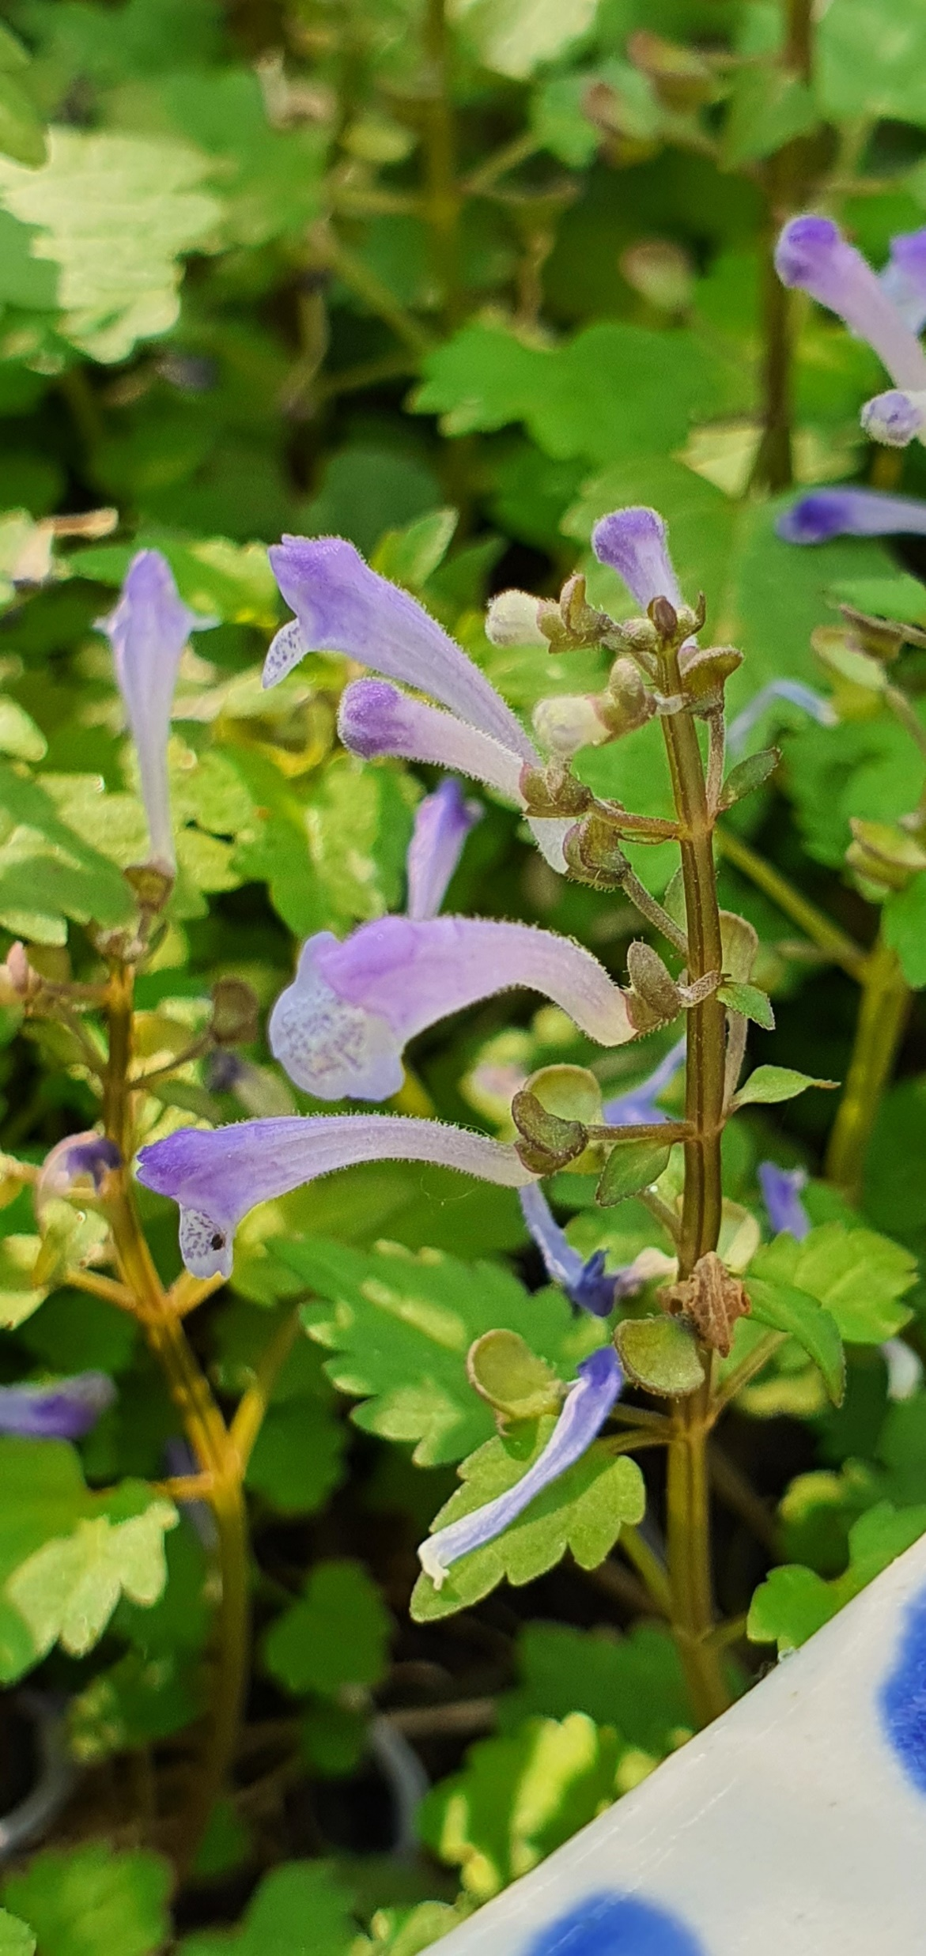
S. havanensis
S. insignis
S. indica var. coccinea
S. barbata
S. racemosa
S. strigillosa
S. dependens
S. wrightii
S. baicalensis
S. tournefortii
S. altissima
S. leonardii
S. pekinensis var. alpina
Figure 3. Representative images of 13 species of Scutellaria selected for additional metabolite and genome size profiling. Scale bar in bottom left of images represents a length of 5 cm. Images without a scale bar did not have a ruler included in the image. Colored circles next to species names indicate the clade which the species belongs to, as indicated in Figure 1.

Slide 5
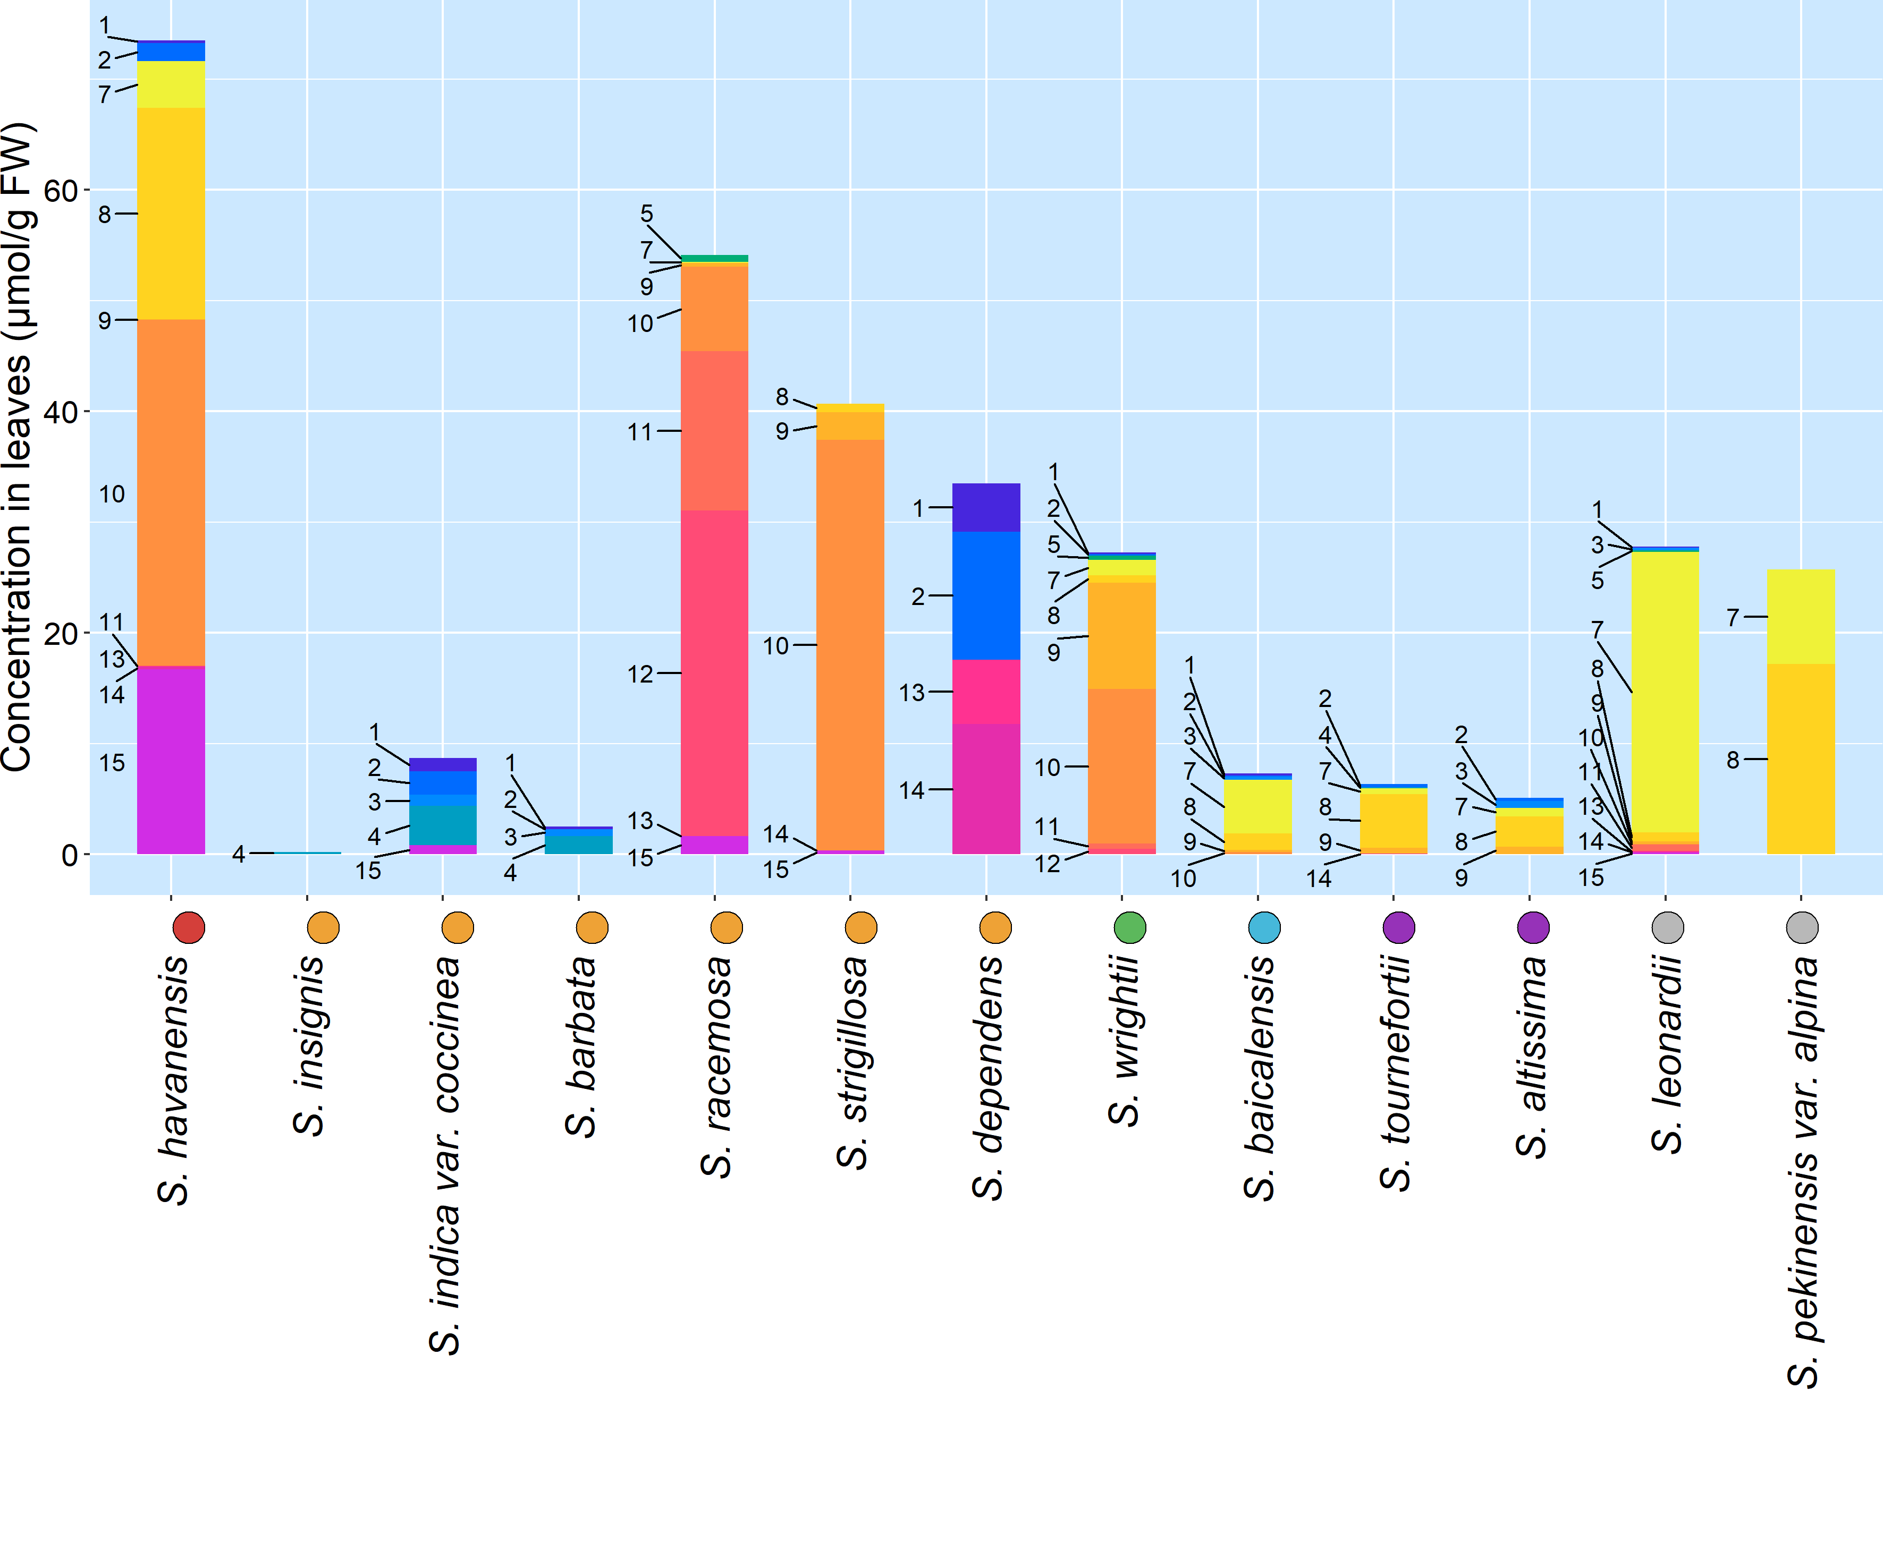
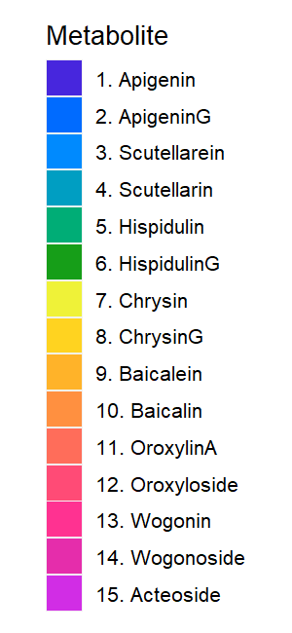
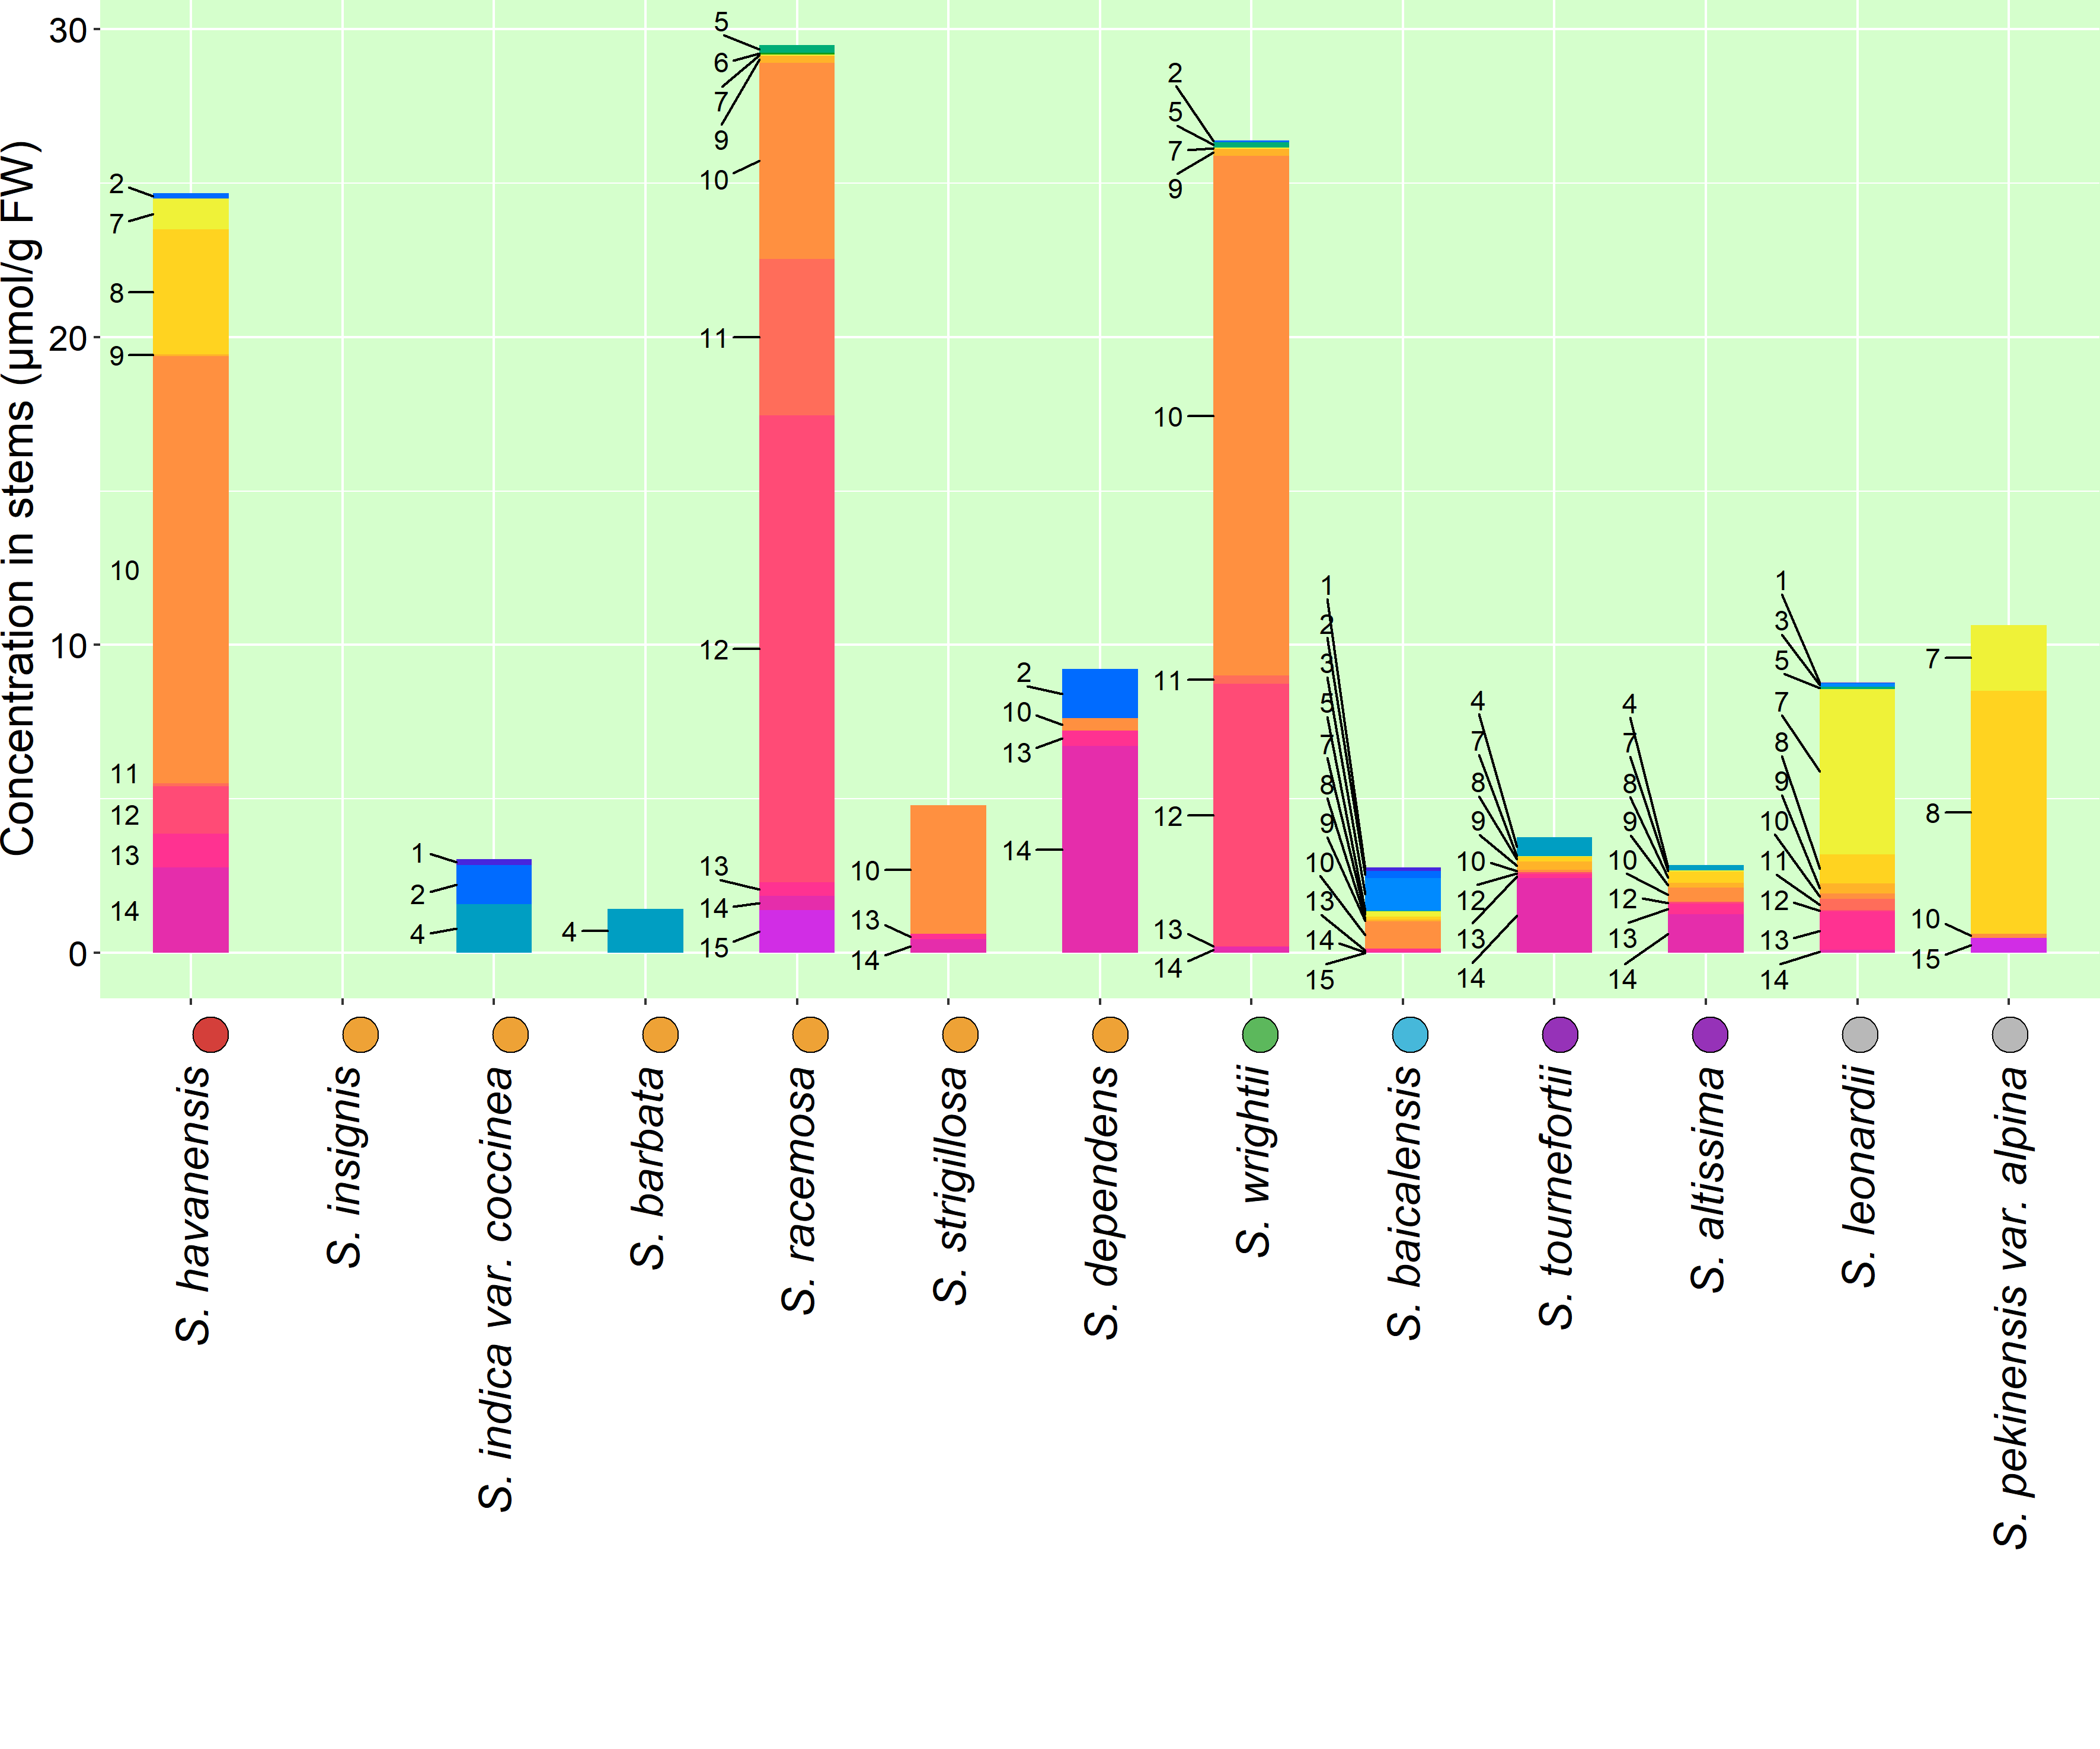
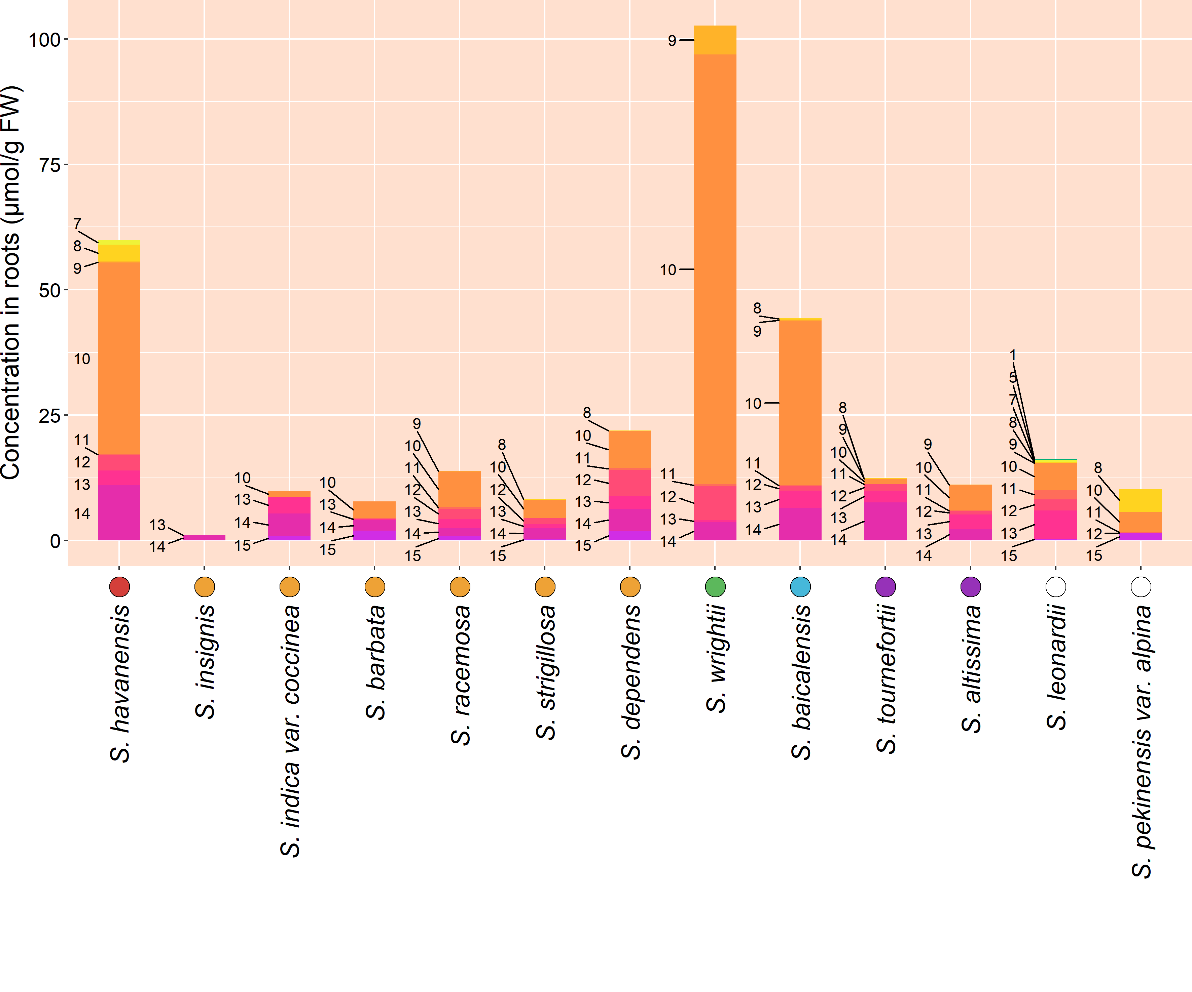
Figure 4. Organ-specific metabolite data collected from 13 Scutellaria species via High Performance Liquid Chromatography (HPLC). Data is shown in units of µmol/g fresh weight. Species on x-axis are ordered based on phylogenetic relationship determined from chloroplast genome data, and colored circles next to species names indicate phylogenetic clade, as shown in Figure 1. An empty circle indicates that the species was not included in the tree from Figure 1.

Slide 6
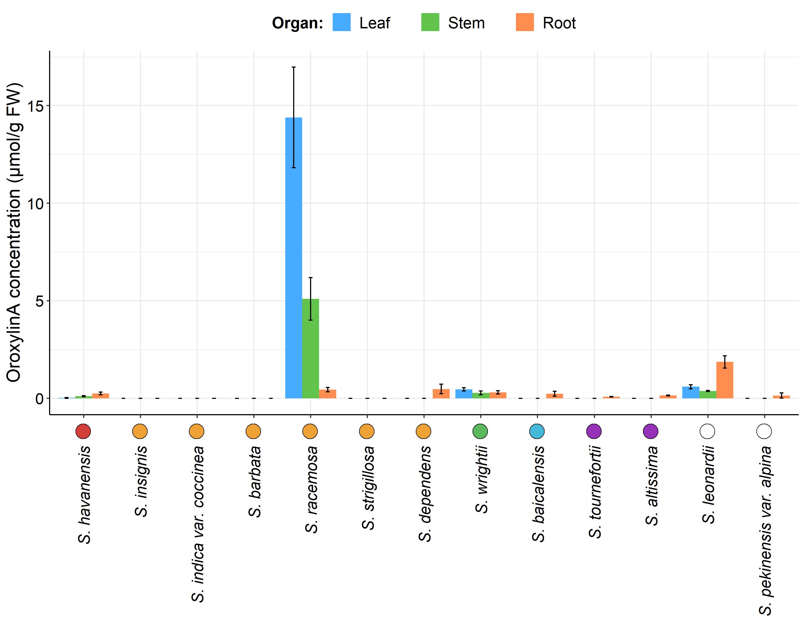
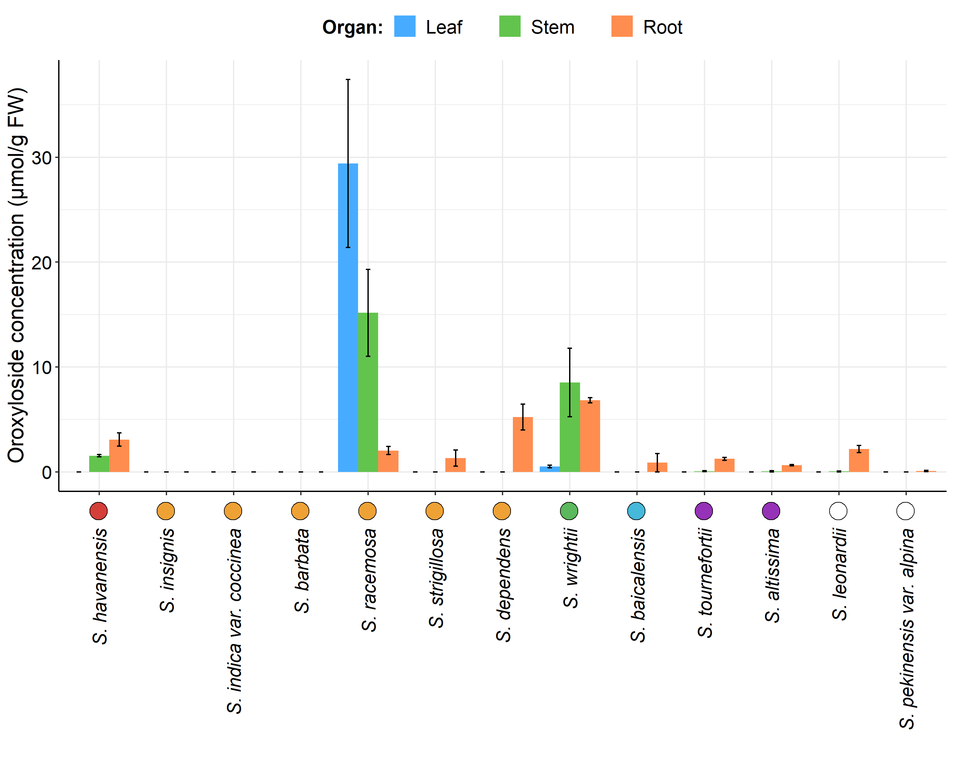
Figure 5. Organ-specific oroxylinA (bottom) and oroxyloside (top) concentrations in 13 Scutellaria species, as determined via High Performance Liquid Chromatography (HPLC). Data is shown in units of µmol/g fresh weight. Concentrations were averaged from tissue samples taken from 3 biological replicates, and error bars represent standard error. Species are ordered based on phylogenetic relationship determined from chloroplast genome data, and colored circles next to species names indicate phylogenetic clade, as shown in Figure 1. An empty circle indicates that the species was not included in the tree from Figure 1.

